Slide 1




Slide 2
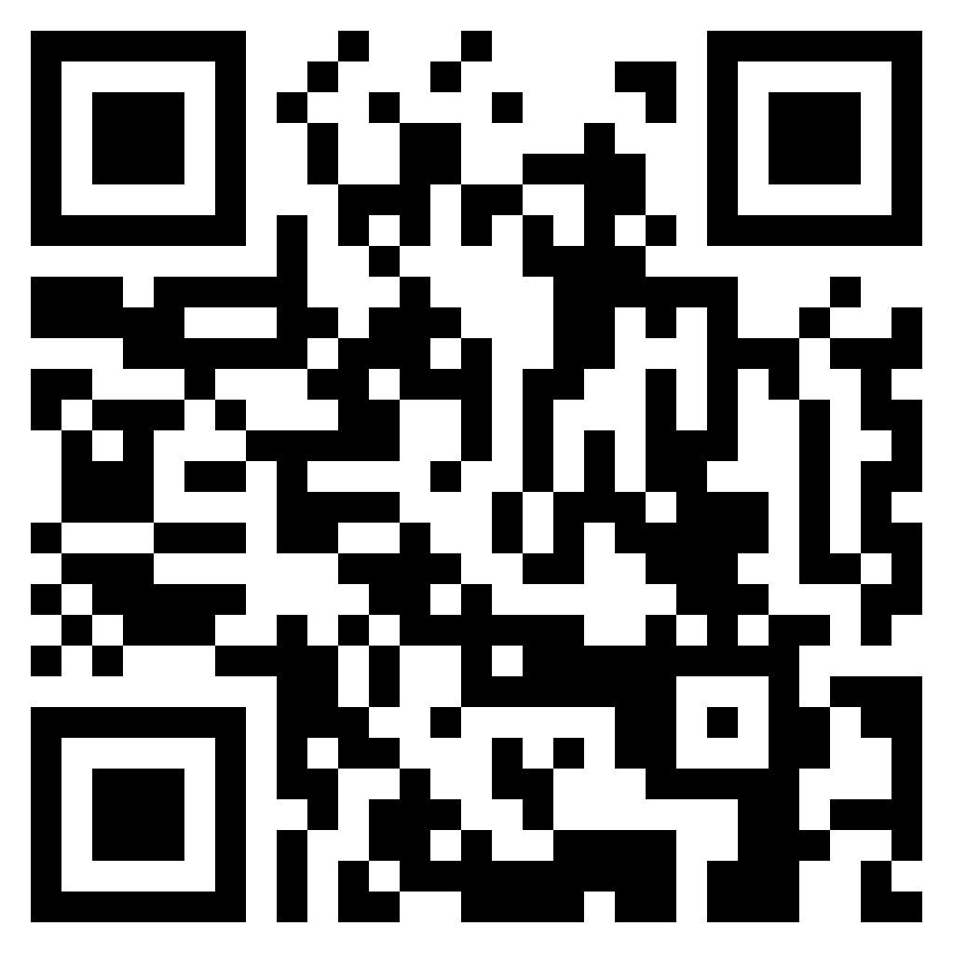
TEST TIME ON EULER’S PHI ALGORITHM
URL: https://forms.gle/hghiSo2Yd4KmiExg6
QR CODE:

Slide 3

STROBOGRAMMATIC NUMBER

Slide 4
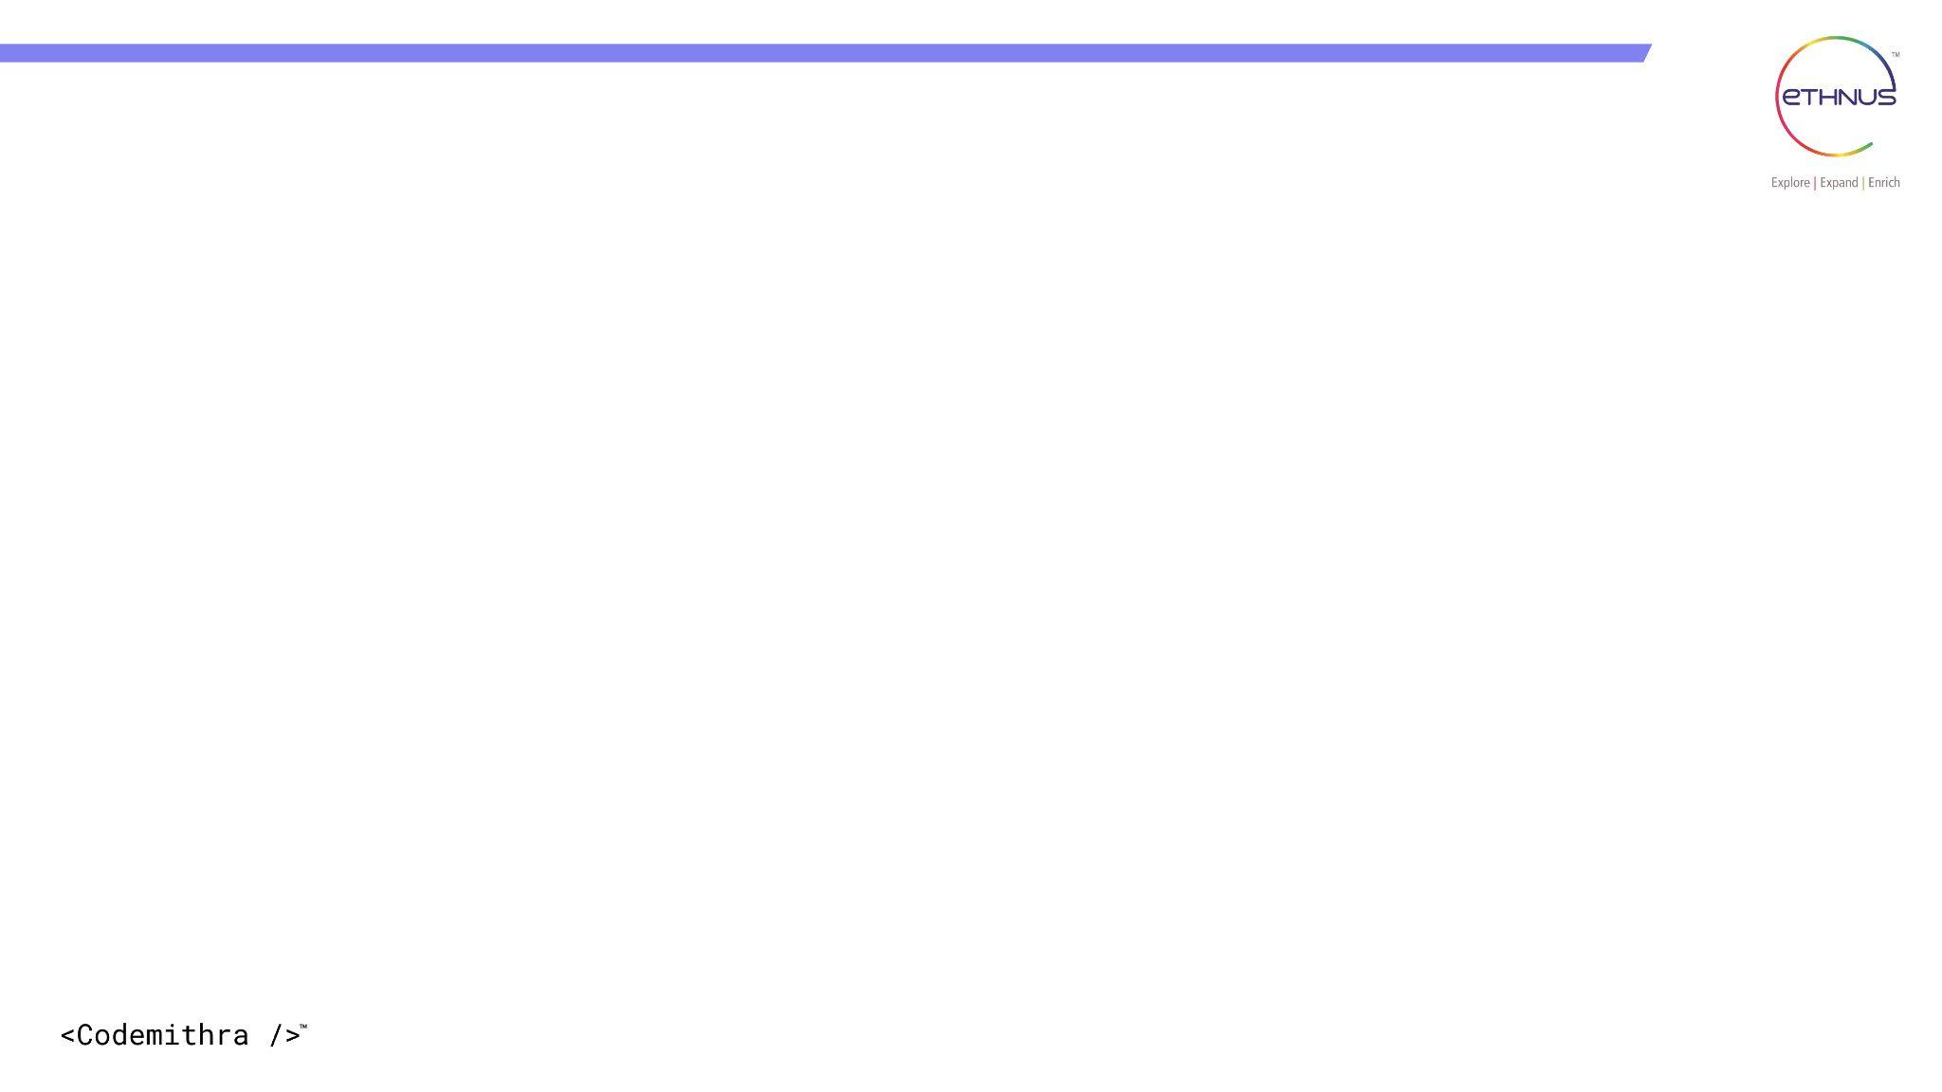

TOPICS
Introduction
Explanation
Coding
Complexity Analysis
Interview Questions

Slide 5
INTRODUCTION
A strobogrammatic number is a number that looks the same when rotated 180 degrees (upside down). In other words, a strobogrammatic number is a number that appears the same when viewed upside down on a seven-segment display, like the numbers 0, 1, 8, 6, and 9.
Here are the strobogrammatic numbers:
0: looks the same upside down
1: looks the same upside down
8: looks the same upside down
6: looks like 9 upside down
9: looks like 6 upside down

Slide 6
INTRODUCTION
Strobogrammatic numbers are interesting in math and computer science because they have some unique properties.
For example, they are often used in programming for things like checking whether a number is a palindrome (a number that reads the same forwards and backward).
Strobogrammatic numbers can also be used to create strobogrammatic palindromes, which are words or phrases that read the same when rotated 180 degrees.
Examples of strobogrammatic palindromes include "NOON", "EYE", and "SOS".

Slide 7
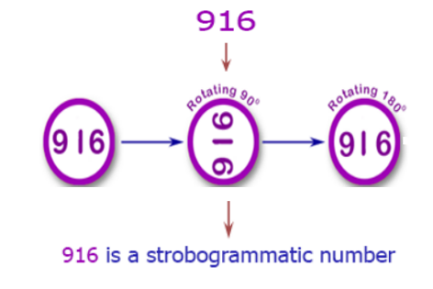
EXPLANATION
The first few strobogrammatic numbers are: 0, 1, 8, 11, 69, 88, 96, 101, 111, 181, 609, 619, 689, 808, 818, 888, 906, 916, 986, 1001, 1111, 1691, 1881, 1961, 6009, 6119, 6699, 6889, 6969, 8008, 8118, 8698, 8888, 8968, 9006, 9116, 9696, 9886, 9966, ...

Slide 8
Program 1
list of all the Strobogrammatic numbers that have a length of 3
import java.util.*;
public class EthCode{
public static ArrayList<String> StrobogrammaticNum(int n){
ArrayList<String> result = numDef(n,n);
return result;}
public static ArrayList<String> numDef(int n, int length){
if(n==0) return new ArrayList<String>(Arrays.asList(new String[] {""}));
if(n==1) return new ArrayList<String>(Arrays.asList(new String[] {"1", "0", "8"}));
ArrayList<String> middles = numDef(n - 2, length);
ArrayList<String> result = new ArrayList<String>();

Slide 9
Program 1
list of all the Strobogrammatic numbers that have a length of 3
for(String middle: middles){
if(n != length)
result.add("0" + middle + "0");
result.add("8" + middle + "8");
result.add("1" + middle + "1");
result.add("9" + middle + "6");
result.add("6" + middle + "9");
}return result;
}
public static void main(String args[]){
System.out.println(StrobogrammaticNum(3));
}}

Slide 10
Program 2
Given number n, check if it is a Strobogrammatic Number.
Sample IO
Input: "69"
Output: 69 is a strobogrammatic number
Input: "88"
Output: 88 is a strobogrammatic number
Input: "962"
Output: 962 is not a strobogrammatic number

Slide 11
import java.util.*;
public class StrobogrammaticNumber {
public static void main(String[] args) {
Scanner sc = new Scanner(System.in);
System.out.println("Enter a number: ");
String num = sc.nextLine(); if(isStrobogrammatic(num)) {
System.out.println(num + " is a strobogrammatic number");
}
else {
System.out.println(num + " is not a strobogrammatic number");
}
sc.close();
}

Slide 12
public static boolean isStrobogrammatic(String num) {
Map<Character, Character> strobogrammaticDictonary = new HashMap<>();
strobogrammaticDictonary.put('0', '0');
strobogrammaticDictonary.put('1', '1');
strobogrammaticDictonary.put('6', '9');
strobogrammaticDictonary.put('8', '8');
strobogrammaticDictonary.put('9', '6');
int n = num.length();
for(int i = 0 , j = (n-1) ; i <= j ; i++, j--){
char digit_left = num.charAt(i);
char digit_right = num.charAt(j);
char mapping = strobogrammaticDictonary.getOrDefault(digit_left, '-');

Slide 13
if(mapping == '-'){
return false;
}
if(mapping != digit_right){
return false;
}
}
return true;
}
}

Slide 14
Complexity Analysis
Let N be the length of the input string.
Time complexity: O(N)
Do a single lookup and comparison for each of the N digits in the string.
Space complexity: O(1)
only use constant extra space. This is an in-place algorithm.

Slide 15
INTERVIEW QUESTIONS

Slide 16
Interview questions
Interview questions
What is a strobogrammatic number?
Answer: A strobogrammatic number is a number that appears the same when rotated 180 degrees. In other words, the digits look the same when the number is flipped upside down.

Slide 17
Interview questions
Interview questions
How would you check if a given number is strobogrammatic in Java?
Answer: One approach is to convert the number to a string and check if the characters in the string form a strobogrammatic pattern.
For example, you could iterate through the string and check if the first and last characters are mirror images of each other, and then move inward towards the center of the string. Alternatively, you could use a lookup table to check for strobogrammatic pairs of digits.

Slide 18
Interview questions
Interview questions
Can you write a Java function to generate all strobogrammatic numbers of a given length?
Answer: Yes, a recursive approach could be used to generate strobogrammatic numbers of a given length. One approach is to define a base case for length 0 and length 1, and then recursively build up longer strobogrammatic numbers by adding digits to the beginning and end of shorter strobogrammatic numbers. In Java, an ArrayList could be used to store the generated strobogrammatic numbers.

Slide 19
Interview questions
Interview questions
Are there any strobogrammatic numbers that are palindromic? In other words, do any strobogrammatic numbers read the same forwards and backwards?
Answer: Yes, the numbers 0, 1, and 8 are strobogrammatic and palindromic.

Slide 20
Interview questions
Can strobogrammatic numbers be negative?
Answer: No, strobogrammatic numbers are always non-negative integers.

Slide 21
Practice questions
Practice questions
Question 1: Check if a number is strobogrammatic
Problem Statement: Given a number as a string, determine if it is strobogrammatic. A number is strobogrammatic if it looks the same when rotated 180 degrees.
Input: A string representing the number.
Output: A boolean value indicating whether the number is strobogrammatic.
Sample Input: "69"
Sample Output: true
Explanation: When "69" is rotated 180 degrees, it becomes "69".
Sample Input: "962"
Sample Output: false
Explanation: When "962" is rotated 180 degrees, it becomes "269", which is not the same as "962".

Slide 22
Practice questions
Practice questions
Question 2: Generate all strobogrammatic numbers of length n
Problem Statement: Given an integer n, generate all strobogrammatic numbers of length n.
Input: An integer n.
Output: A list of strings representing all strobogrammatic numbers of length n.
Sample Input: 2
Sample Output: ["11", "69", "88", "96"]
Explanation: These are the 2-digit numbers that look the same when rotated 180 degrees.

Slide 23
Practice questions
Question 3: Find the smallest strobogrammatic number greater than a given number
Problem Statement: Given a number as a string, find the smallest strobogrammatic number that is greater than the given number.
Input: A string representing the number.
Output: A string representing the smallest strobogrammatic number greater than the given number.
Sample Input: "50"
Sample Output: "69"
Explanation: The smallest strobogrammatic number greater than "50" is "69".
Sample Input: "88"
Sample Output: "96"
Explanation: The smallest strobogrammatic number greater than "88" is "96".

Slide 24
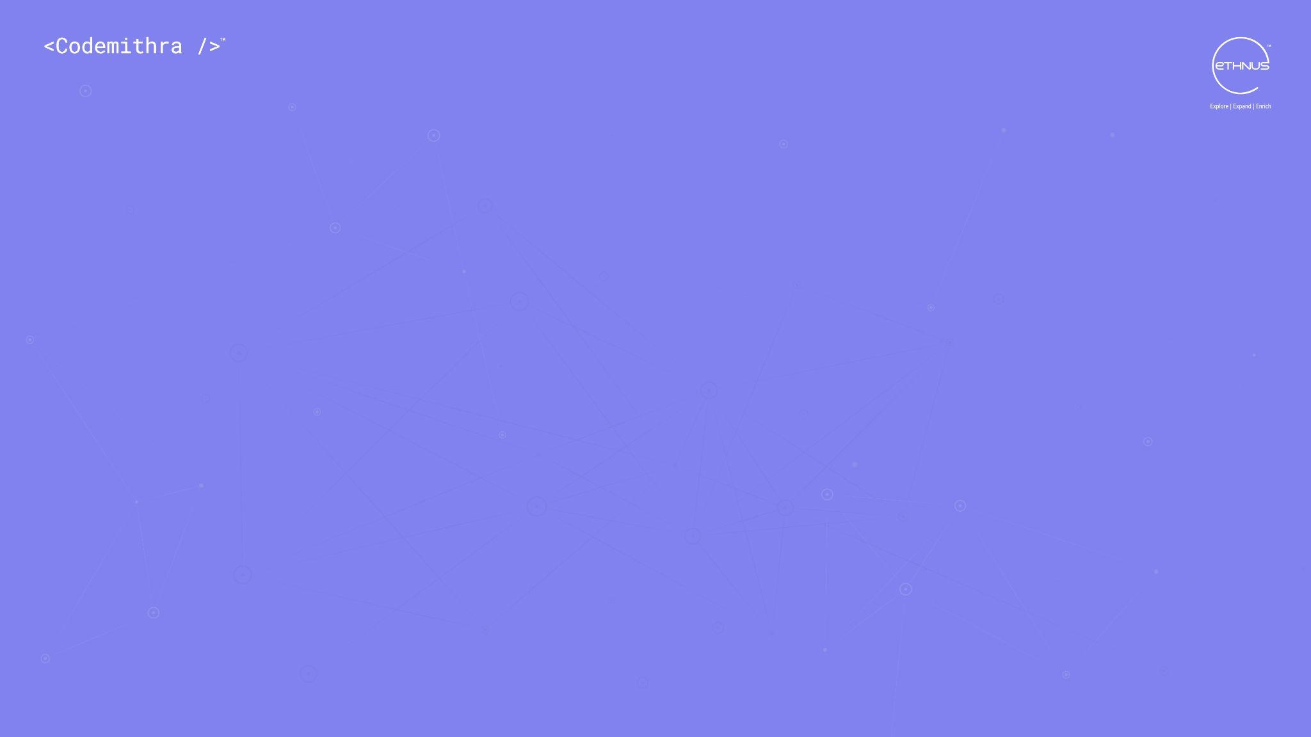



THANK YOU
+91 78150 95095
codemithra@ethnus.com
www.codemithra.com

